Slide 1
Virtual Machine Survey
Edison Tsui, Zakkaria Lamliki

Slide 2
Rundown
Introduction of VMM
  Benefit
  Classification
Virtualization Requirement & Technique
  CPU Virtualization
    Pure Virtualization, Binary Translation, Para-virtualization….
  Memory Virtualization
  I/O Virtualization
Security Opportunity and Challenges
Conclusion

Slide 3
Introduction
What is virtualization Machine Monitor (VMM)
  A thin layer of software in the middle of OS and Hardware
  Allow running multiple guest OS on top of single piece of hardware
OS
OS
VMM
Hardware
Hardware

Slide 4
Benefit from Virtualization
Utilization of hardware
  From “one-service-one-machine” to multiplex multiple services in one machine
  Isolation
Ease of Management
  Migration
  Checkpoint and Rollback
Compatibility
Software Distribution

Slide 5
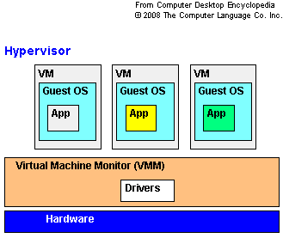
Classification
Type 1
  on the host’s hardware
  higher virtualization
  Example
    LDom, LPAR, VMware ESX

Slide 6
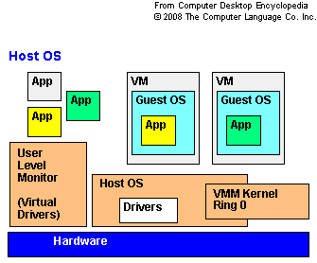
Classification
Type 2
  on conventional OS
  support of a broad range of I/O devices
  Example
    VirtualBox
    Parallels Workstation

Slide 7
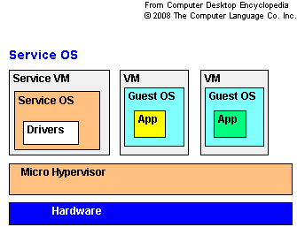
Classification
Hybrid Type
  Combination of
    robustness of the type 1 model
    flexibility of the type 2 model

Slide 8
Virtualization Requirement
Popek and Goldberg
  Equivalency
  Efficiency
  Resource Control

Slide 9
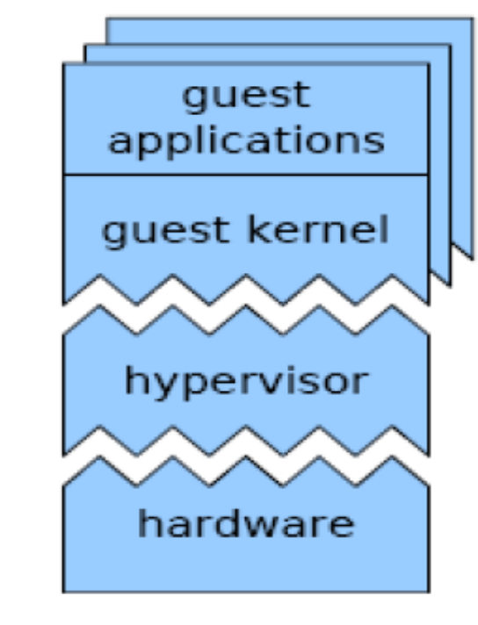
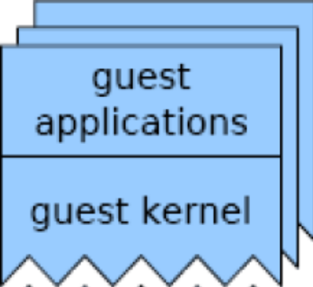

CPU Virtualization
Impact of bringing in VMM
  De-privilege
Less Privileged Level
Most Privileged Level

Slide 10
CPU Virtualization
Executing Non-privileged Instruction
  Behave the same
Case 1: Non-privileged Instruction
Less Privileged Level
Most Privileged Level

Slide 11
CPU Virtualization
Executing Privileged Instruction
  Processor will trap back to VMM
  VMM can emulate
Trap and Emulate
Case 2: Privileged Instruction
Less Privileged Level
Most Privileged Level

Slide 12
CPU Virtualization
Executing Sensitive but non-privileged instruction
  Behave differently under different Privilege Level
Case 3: Sensitive but non-privileged Instruction
Less Privileged Level
Potential Problem
Most Privileged Level

Slide 13
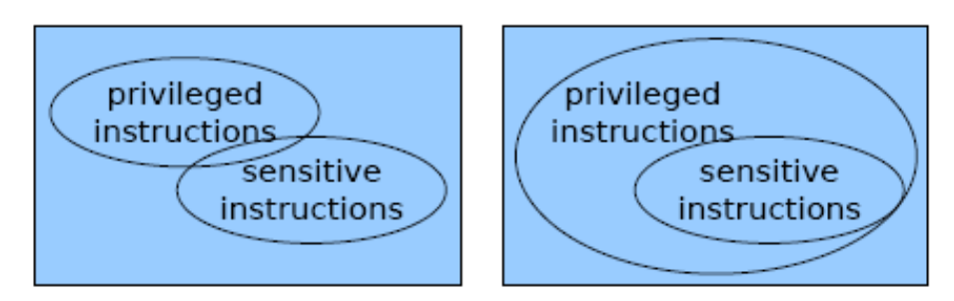
CPU Virtualization
Pure virtualization
  Processor Instruction Set is fully virtualizable
    “a CPU architecture is virtualizable if the set of sensitive instructions is a subset of privileged instructions” [3]

Slide 14
CPU Virtualization
Pure Virtualization
  Advantage
    Guest OS can run on VMM without modification
  Challenges
    Not all processor instruction set are virtualizable, including x86
    Heavy overhead when switching between privilege levels

Slide 15
CPU Virtualization
Binary Translation [33], [13]
  replace binary code that cannot be directly executed on the fly
    PC-relative addressing
    Direct control flow
    Indirect control flow
    Privileged instructions
  Other code block remain identical

Slide 16
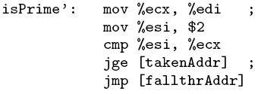
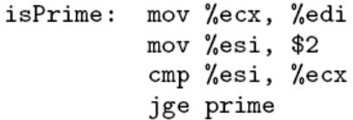
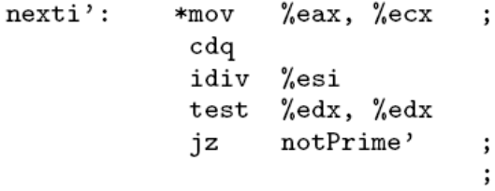
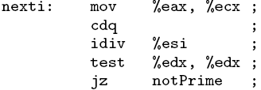
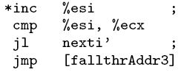


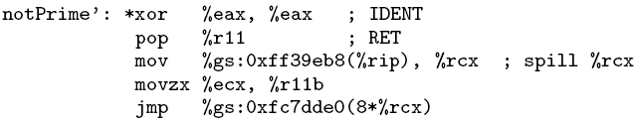
CPU Virtualization
Case Study
Execute
Translator
Translation Unit (TU) in binary
Compiled Code Fragment (CCF)

Slide 17
CPU Virtualization
Binary Translation
  Advantage
    Guest OS kernel do not need to be modified
  Disadvantage
    The translation can be complicated

Slide 18
CPU Virtualization
Para-virtualization[11][12]
  Introduce co-design of VMM and guest OS kernel
  Guest OS kernel need to be modified to
    handle sensitive but non-privileged instructions
    avoid frequent trap into hypervisor for better performance

Slide 19
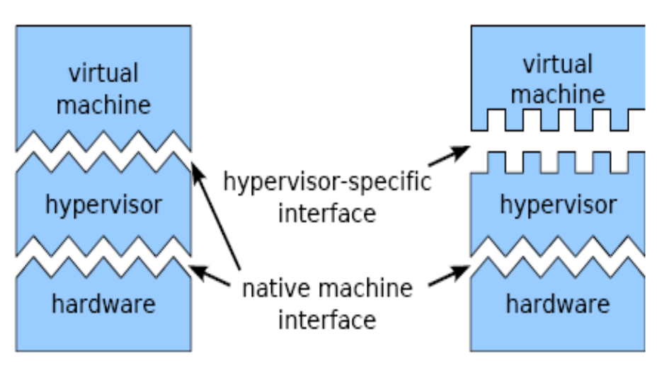
CPU Virtualization
Pre-virtualization
  Advantage
    Better performance
  Disadvantage
    Compatibility
      Unmodified guest OS cannot run on top of VMM
      Modified guest OS cannot run on native hardware
    Engineering Effort
      Degree of engineering effort varies from projects

Slide 20
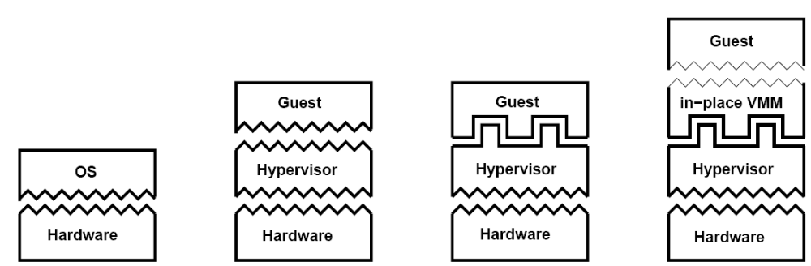
CPU Virtualization
Pre-virtualization[16][17]
  Soft-layering principle
  In-place VMM (IPVMM) to mediate Guest OS and VMM
  Well defined basis for kernel modification
    Can be automated

Slide 21
CPU Virtualization
Pre-virtualization
  Advantage
    Compatibility
    Lower Engineering Cost
  Disadvantage
    Overhead form IPVMM

Slide 22
CPU Virtualization
Hardware-assisted

Slide 23
Memory Virtualization

Slide 24
I/O Virtualization

Slide 25
Security Aspect
Opportunity
  Can VMM bring better security?
    Intrusion Detection System (IDS)
    Trusted VMM
  Simple Example
    Utilize VMM isolation property
    Specify a VM for online-banking

Slide 26
Security Opportunity: Intrusion Detection System
Traditional IDS trade off
  Visibility
    Ability to inspect hardware and guest OS software state and event
  Isolation
    Ability to be isolated from malware attack
Traditional IDS reside in
  Network
  Host OS
VMM can provide better visibility and isolation
  Simple and Constrained Interface
  Simple Protection Mode
  Simple architecture and small code size

Slide 27
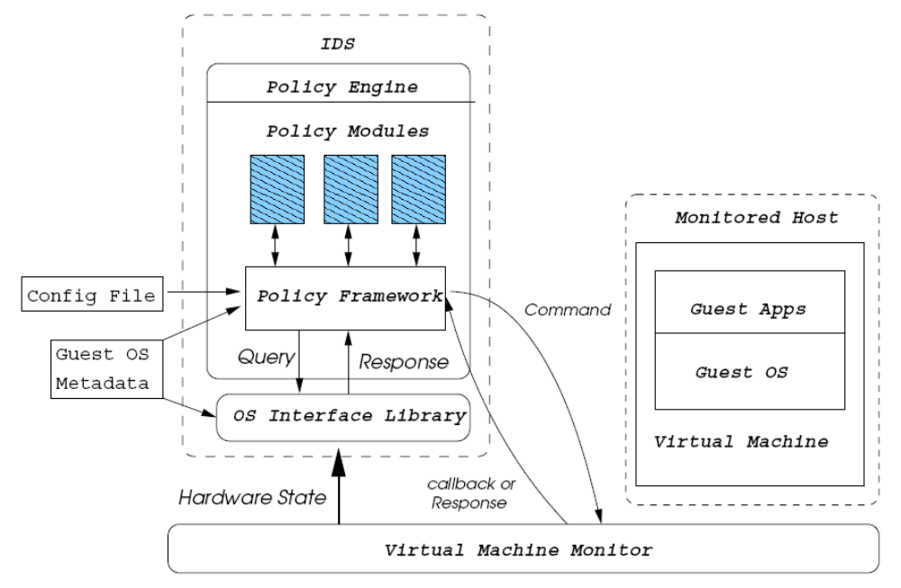
Security Opportunity: Intrusion Detection System
Example
  LiveWire[24]

Slide 28
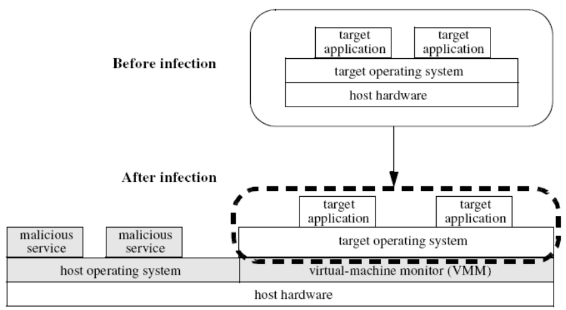
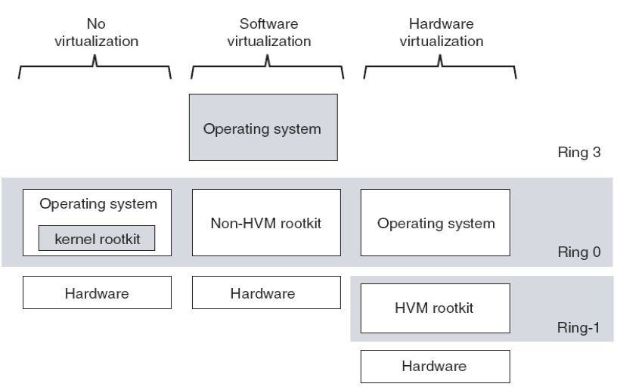
Security Challenge
Malware
  Virtual Machine Based RootKit (VMBR)
  Layer-below attack
  Hardware Virtual Machine based RootKit (HVM Rootkit)
    Claim impossible for detection
    BluePill [39]

Slide 29
Security Challenge
VMBR Detection & Defense
  Side Channel Information
  RedPill [40] (apply to VMBR only)
    Sensitive but non-privilege instruction, e.g. SIDT
  VMBR can be avoided by installing VMM beforehand

Slide 30
Security Challenge
New User behavior and management issue
  Patch Management
  Rollback Problem
    State is kept unchanged
    Possible seed reuse
  Data Mobility

Slide 31
Q & A

Slide 32
Reference
[1] R.P. Goldberg, “Survey of Virtual Machine Research”, 1974
[2] M Rosenblum, T Garfinkel, “Virtual Machine Monitors: Current Technology and Future Trends”- Computer, 2005 - ieeexplore.ieee.org
[3] Gerald J. Popek and Robert P. Goldberg. Formal requirements for virtualizable third generation architectures. Communications of the ACM, 17(7):412–421, 1974.
[4] JE Smith, R Nair , “The architecture of virtual machines”, Computer, 2005 - ieeexplore.ieee.org
[5] R Rose, “Survey of system virtualization techniques”, Retrieved March, 2004 - robertwrose.com
[6] Poul-Henning Kamp Robert N. M. Watson, “Jails: Confining the omnipotent root”.
[7] Khairil Yusof ,“FreeBSD Jails: Lightweight Virtualization”.
[8] Octave Orgeron (Sun Microsystem) “An introduction to Logical Domains.”
[9] Menno Lageman, “Sun Client Solutions : Solaris Containers — What They Are and How to Use Them”
[10] E Bugnion, S Devine, K Govil, M Rosenblum , “Disco: Running commodity operating systems on scalable multiprocessors”, ACM Transactions on Computer Systems, 1997 - portal.acm.org
[11] P Barham, B Dragovic, K Fraser, S Hand, T Harris , “Xen and the art of virtualization”, ACM SIGOPS Operating Systems Review, 2003 - portal.acm.org
[12] Andrew Whitaker, Marianne Shaw, and Steven D. Gribble. Scale and performance in the denali isolation kernel. ACM SIGOPS Operating Systems Review, 36(SI):195–209, 2002.
[13] K Adams, O Agesen“A comparison of software and hardware techniques for x86 virtualization”, 2006 - portal.acm.org
[14] Rich Uhlig, Gil Neiger, Dion Rodgers, Amy L. Santoni, Fernando C. M. Martins, Andrew V. Anderson, Steven M. Bennett, Alain Kagi, Felix H. Leung, and Larry Smith. Intel virtualization technology. IEEE Computer, 38(5):48–56, 2005.
[15] Advanced Micro Devices, Inc. AMD64 Virtualization Codenamed Pacifica Technology, Secure Virtual Machine Architecture Reference Manual. Austin, TX, USA, 2006.
[16] J LeVasseur, V Uhlig, B Leslie, M Chapman, G Heiser, “Pre-virtualization: uniting two worlds”, Proceedings of the twentieth ACM symposium on Operating systems principles
[17] J LeVasseur, V Uhlig, B Leslie, M Chapman, G Heiser, “Pre-virtualization: software layering for virtual machine”
[18] Logical Domains 1.0.3 Admin Guide
[19] Ashley Saulsbury, “UltraSPARC Virtual Machine Specification”
[20] J. P. Casazza, M. Greenfield, and K. Shi, “Redefining Server Performance Characterization for Virtualization Benchmarking”, Intel Technology Journal, 2006, 10(3):243-252.
[21] D. Gupta, R. Gardner, and L. Cherkasova, “XenMon: QoS monitoring and performance profiling tool”, HP Labs Technical Report, HPL-2005-187, October 2005.
[22] Menon, JR Santos, Y Turner, GJ Janakiraman, Willy Zwaenepoel , “Diagnosing performance overheads in the xen virtual machine environment”, usenix.org
[23] Diwaker Gupta (UC San Diego), Lucy Cherkasova (HP Labs), Rob Gardner (HP Labs), Amin Vahdat (UC San Diego), “Performance Isolation in XEN”.
[24] T Garfinkel, M Rosenblum , “A virtual machine introspection based architecture for intrusion detection”, Proc. Network and Distributed Systems Security Symposium, 2003 - eprints.kfupm.edu.sa
[25] T Garfinkel, B Pfaff, J Chow, M Rosenblum, D Boneh , “Terra: A virtual machine-based platform for trusted computing” - portal.acm.org
[26] ST King, PM Chen , “SubVirt: Implementing malware with virtual machines” - 2006 IEEE Symposium on Security and Privacy, 2006 - ieeexplore.ieee.org
[27] GW Dunlap, ST King, S Cinar, MA Basrai, PM Chen , “ReVirt: Enabling intrusion analysis through virtual-machine logging and replay”,- ACM SIGOPS Operating Systems Review, 2002 - portal.acm.org
[28] C SE, Y RESPONSE , “A Testing Methodology for Rootkit Removal Effectiveness”, symantec.com
[29] T Garfinkel, M Rosenblum, “When Virtual is harder than Real: Security Challenges in Virtual Machine Based Computing Environments”
[30] J. S. Robin, C. E. Irvine, “Analysis of the Intel Pentium Ability to support a Secure Virtual Machine Monitor”, USENUX Security Symposium, pp 129-144, 2000
[31] R. Goldberg. Architectural Principles for Virtual Computer Systems. Ph.D. thesis, Harvard University, Cambridge, MA, 1972.
[32] R. J. Creasy, “The Origin of the Vm/370 Time-Sharing System”, IBM Journal of Research and Development, vol 25, no 5, p 483, 1981
[33] R. Sites er al., “Binary Translation”, Comm, ACM, Feb 1993, pp 69-81
[34] Tony Shoumack, “BEGINNERS GUIDE TO LDOMS: UNDERSTANDING AND DEPLOYING LOGICAL DOMAINS"
[35] T Garfinkel, K Adams, A Warfield, J Franklin , “Compatibility is not transparency: VMM detection myths and realities” - Proceedings of the 11th Workshop on Hot Topics in Operating System - usenix.org
[36] K Skapinetz, “Virtualisation as a blackhat tool”, Network Security, Oct 2007
[37] KG Anagnostakis, S Sidiroglou, P Akritidis, K Xinidis, E Markatos, “Detecting targeted attacks using shadow honeypots”, - usenix.org
[38] A Joshi, ST King, GW Dunlap, PM Chen , “Detecting past and present intrusions through vulnerability-specific predicates”, - Proceedings of the twentieth ACM symposium on Operating System Principles, pp 91-104, 2005 - portal.acm.org
[39] Blue Pill Project, www.bluepillproject.org, Invisible Things Lab
[40] J. Rutkowska, “Red Pill or how to detect VMM using (almost) one CPU instruction”, 2005
[41] P. Ferrie, N. Lawason, T. Ptacek, “Don’t Tell Joanna, The Virtualised Rootkit Is Dead” In Proceedings of Black Hat USA 2007,
[42] A. Seshadri, M. Luk, E. Shi, A. Perrig, L. van Doorn, and P. Khosla. Pioneer: Verifying integrity and guaranteeing execution of code on legacy platforms. In Proceedings of ACM Symposium on Operating Systems Principles (SOSP), pages 1–16, 2005
[43] Y.-M. Wang, D. Beck, B. Vo, R. Roussev, and C. Verbowski. Detecting Stealth Software with Strider GhostBuster. In Proceedings of the 2005 International Conference on Dependable Systems and Networks (DSN), June 2005.
[44] M Carbone, D Zamboni, W Lee, “Taming Virtualization”, - IEEE Security & Privacy, 2008 - ieeexplore.ieee.org

